Slide 1

NATIONAL SPORTS AUTHORITY
Propelling Ghana to high international recognition

Slide 2
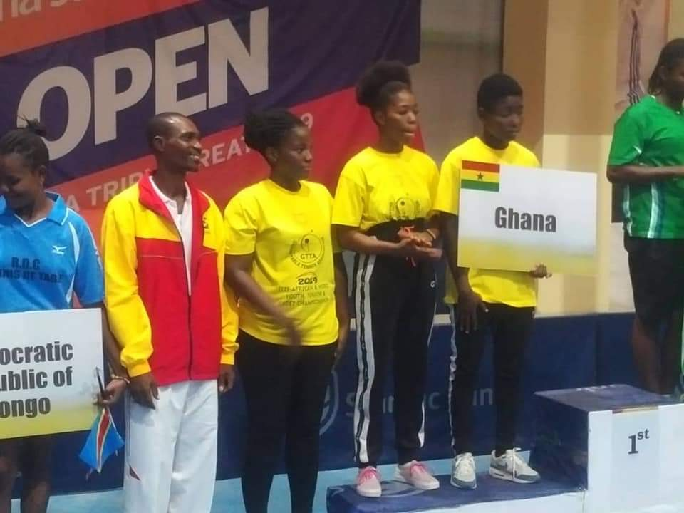
NSA Boss Applauds National U12 Tennis Team
22, June 2019
Sports Authority Director-General Prof. Peter Twumasi praises the National Tennis under 12 team for excelling in the just ended ITF/CAT west and central Africa championship held in Cotonou Benin. The teams splendid performance earned them qualiﬁcation for the main ITF/CAT union Championship scheduled for September. The presentation was made when a delegation from the Ghana Tennis Federation led by the resident Isaac Aboagye, Secretary General philipina Frimpong, Coach Noah Bagerbaseh Richard Ayi Dartey, Henry Quansah and some parents of the 12 and under team. The purpose of the meeting was to officially present to the NSA director the trophy the team won in the competition at the at the epense other est entral Africa countries.

Slide 3
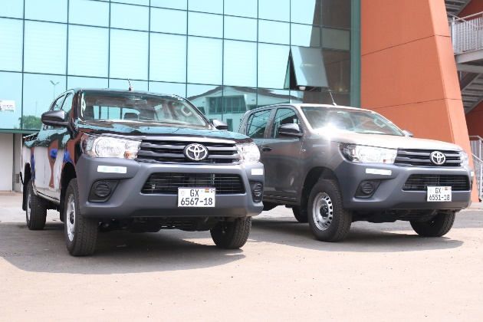
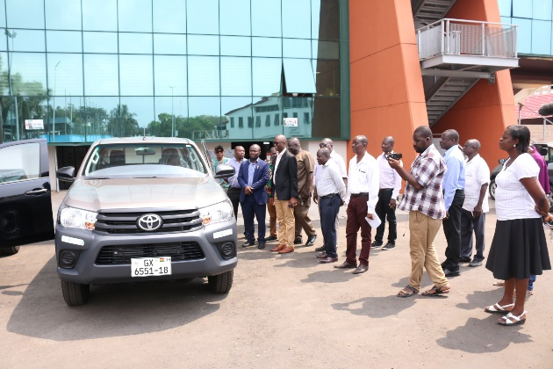
NSA Outdoors New Vehicles
27th January,2 019
The National Sports Authority outdoor two new Toyota Hilux pickups at a short ceremony in Accra on Monday 28th January 2019. Officials of the Authority led by the Director-General, Prof. Peter Twumasi, I inspected the vehicles and thanked Hon. Isaac Asiamah and the Ministry of Youth and Sports, for this timely intervention, which is expected to ease the current transportation challenges.
Speaking to the media at the ceremony, he indicated that the Ministry of Youth and Sports in its quest to use sports as a tool for development will resource the National Sports Authority with the needed logistics including vehicles in order to achieve this objective. He appealed for the supply of vehicles for the entire ten regional sports directorate to help promote sports development at the grass-root level

Slide 4
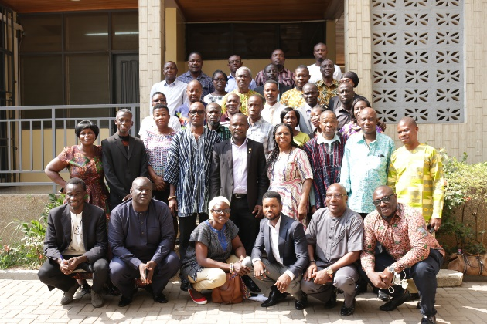
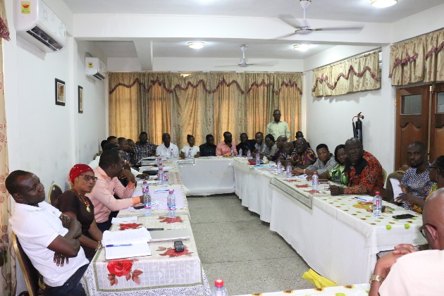
NSA Runs Refresher Course For Staff
29th January,2 019
The National Sports Authority (NSA) is working to build the capacity of its core staff for optimum performance in the discharge of their duties. In an interview with NSA NEWS, the Director General of the National Sports Authority, Professor Peter Twumasi, indicated that the Authority will run regular refresher courses for its staff nationwide in line with the authority’s vision.
He made this comments at the closing ceremony of the two-day Training Workshop for its Regional Directors, administrators and accountants in Kumasi. The programme was packaged to improve the leadership and managerial skills of the participants. Resource persons were selected from the controller and accountant general department and KNUST.

Slide 5
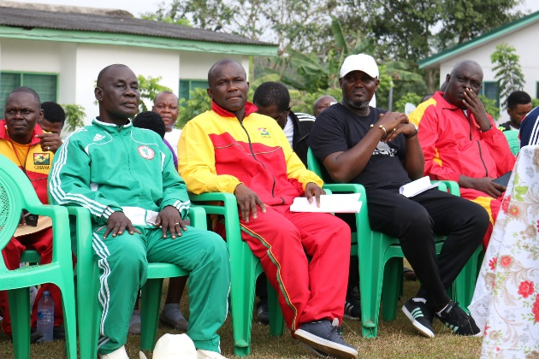
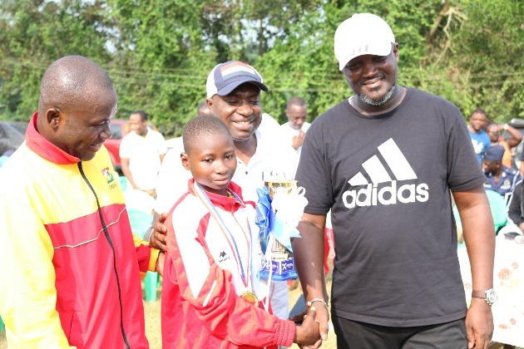
National Cross Country
7th to 9th February,2 019
Colorful national cross Country event took place at Mpohor in the western region from 7th to 9th February,2 019. Six males and females respectively from each region participated in the event which covered a distance of ten kilometers. Malik Yakubu of the Ashanti Region emerged winner of the male category whiles Ramata Abdulai from the Upper West Region won the female category. The Guest of Honour was Hon. Curtis Perry Okudjeto, Deputy Minister of Youth and Sports who stood in for the Minster, Hon. Isaac Kwame Asiamah. Other Diginitaries include Director-General of the National Sports Authority, Prof. Peter Twumasi, the Omanhene of Wassa Mpohor traditional area, Osabarima Kow Entsie II, Kontihene of Wassa Mpohor, Member of Parliament for Mpohor constituency, Hon. Alexander Agyekum, Municipal Chief Executive Officer of Mpohor, Hon. Ignatius Saa Mensah, former Western Regional Minister, Municipal Chief Executive Officer of Mpohor, Hon. Ignatius Saa Mensah, former Western Regional Minister, Hon. A.E. Amoah among others.

Slide 6
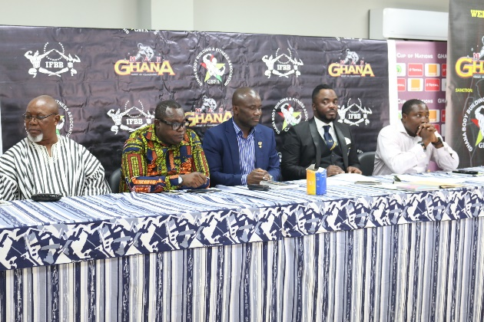
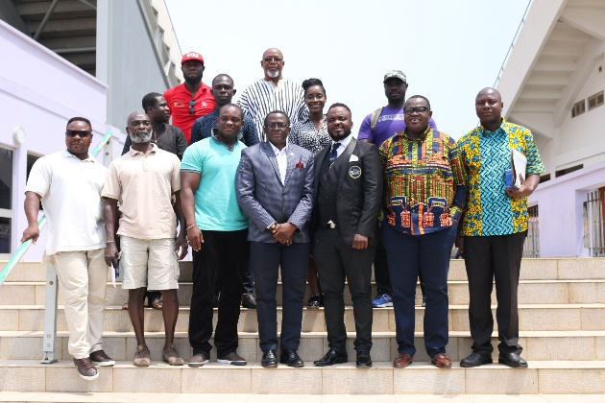
GBFA Receives Support From NSA Ahead Of Arnolds Classic Africa
19th February, 2019
The National Sports Authority (NSA), has presented three flight tickets to the Ghana Body Building and Fitness Association (GBFA).
The tickets are to cater for the travel of three body builders to participate in the annual Arnold Classic Africa Body Building competition, in Johannesburg, South Africa, from May 17 to 19.
Mr Abdul Haye Yartey, President of the GBFA, who received the tickets on behalf of the association expressed appreciation to the NSA and Professor Peter Twumasi, Director General for NSA for coming to their aid.
He said, they further support from individuals and corporate bodies to enable them to participate in the competition.

Slide 7
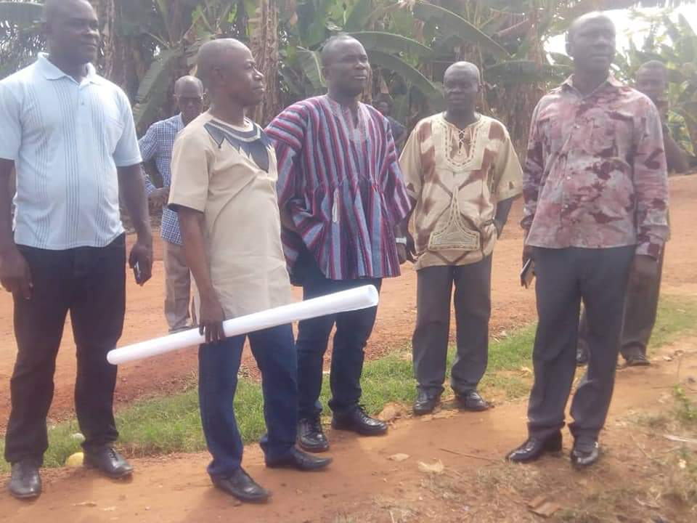
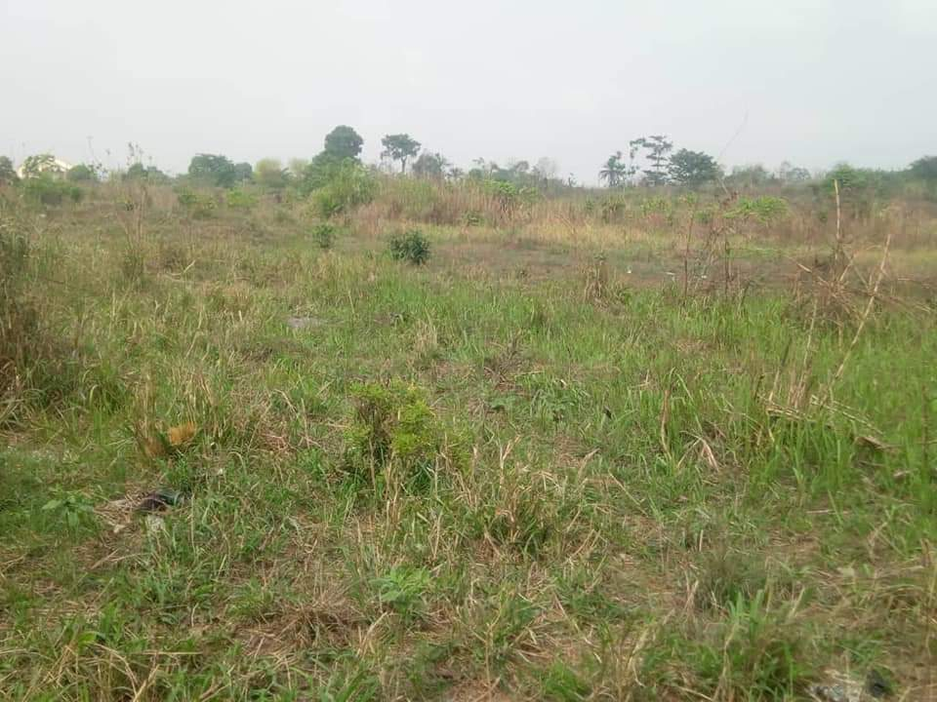
Inspection of Land Site For Stadium Construction At Asante Mampong
23rd February, 2019
As part of his visit to Ashanti Region, Prof Peter Twumasi inspected a National Sports Authority's land site at Asante Mampong to ﬁnalize its acquisition for stadium construction. The MCE and Elders of the Municipality accompanied the oﬃcials of the Authority for the inspection.

Slide 8
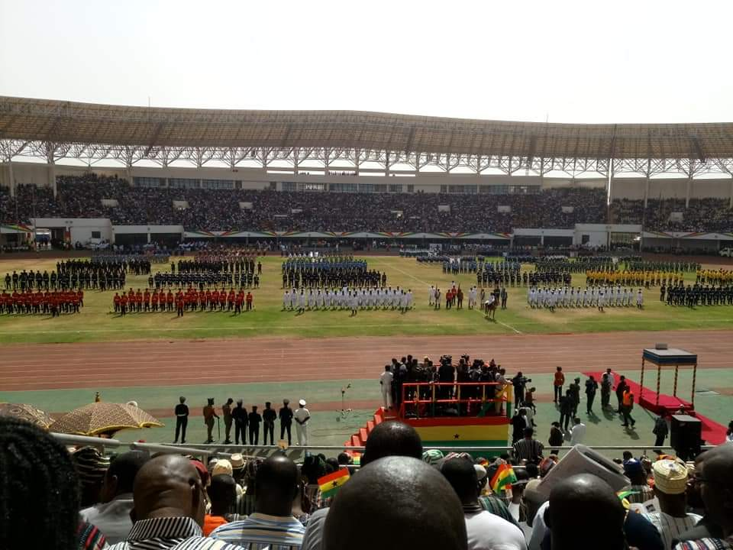
62nd Ghana's Independence Celebration
5th March, 2019
National Sports Authority inspection revealed work near completion for the hosting of 62nd Ghana's Independence Celebration at Alhaji Aliu Mahama Sports Stadium in Tamale. Prof Twumasi congratulated all participating teams especially Ag Regional Director and her staff and wished all Ghanaians a happy anniversary and God's blessings.

Slide 9
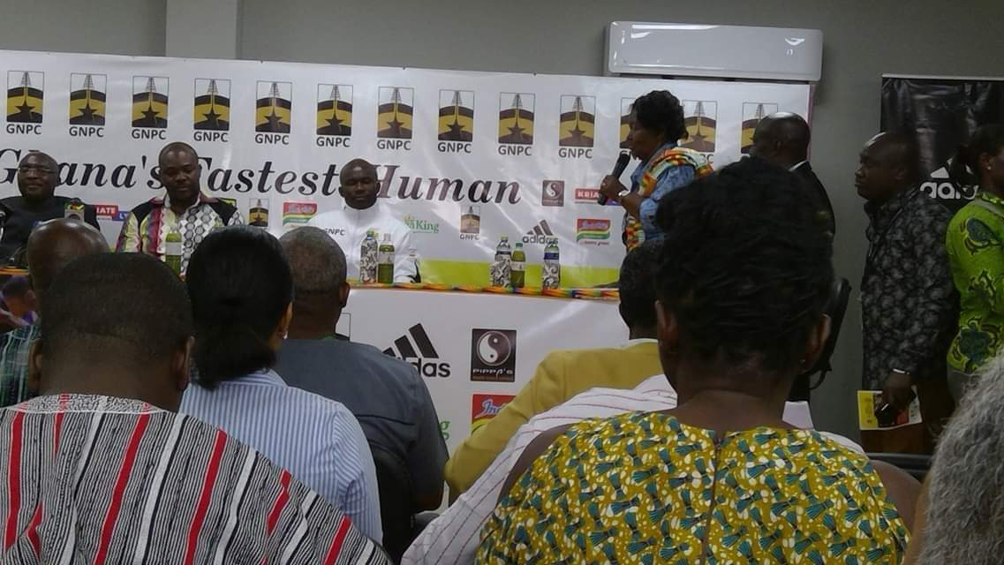
Government Officials Attends The Launch Of Ghana’s Fastest Human Project
March 15 2019
Prior to Ghana's Fastest Human project, Director General of National Sports Authority, Prof Peter Twumasi together with the Vice President, Dr M. Bawumia and Minister of Youth and Sports, Hon Isaac Asiamah attended the launch of Ghana's Fastest Human project. The purpose of the programme is to identify and develop sprinters across the country

Slide 10
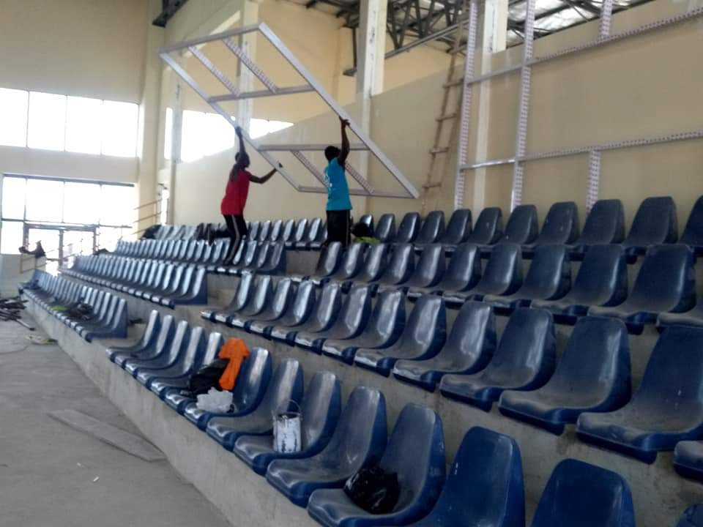
Inspection Of Work At Bukom Emporium in Accra
26, March 2019
Anterior to the World Table Tennis Junior Championship to be held in Ghana, The Director-General of the Authority
Inspected work done at Bukom Emporium in Accra.

Slide 11
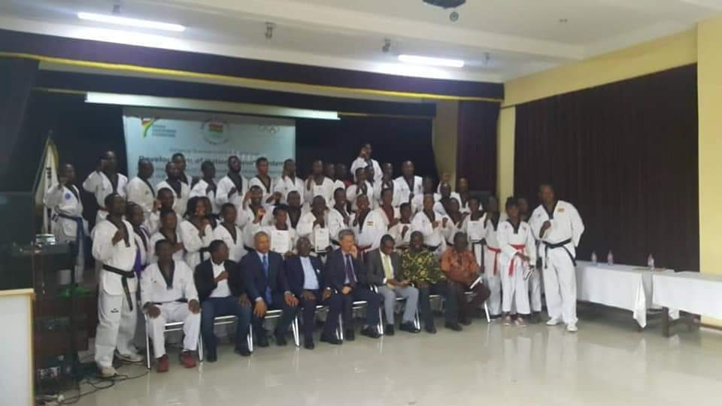
NSA, IOC attends a Training And Licensing Course Organized By Ghana Taekwondo Federation
13th April 2019
Prof Twumasi attended a Closing Ceremony of a training and licensing course organized by Ghana Taekwondo Federation with the support of International Olympic Committee, Republic of South Korea and NSA at the Korean Sports Complex (Accra). A total of 42 couches pooled from all regions in Ghana passed out and received licenses to practice. Additionally, 20 administrators, two from each of the ten regions, were trained to manage online database for oﬃcials and sportsmen and women in the Federation. Ghana is collaborating with Korea to increase the number of Sports Halls across the country.

Slide 12
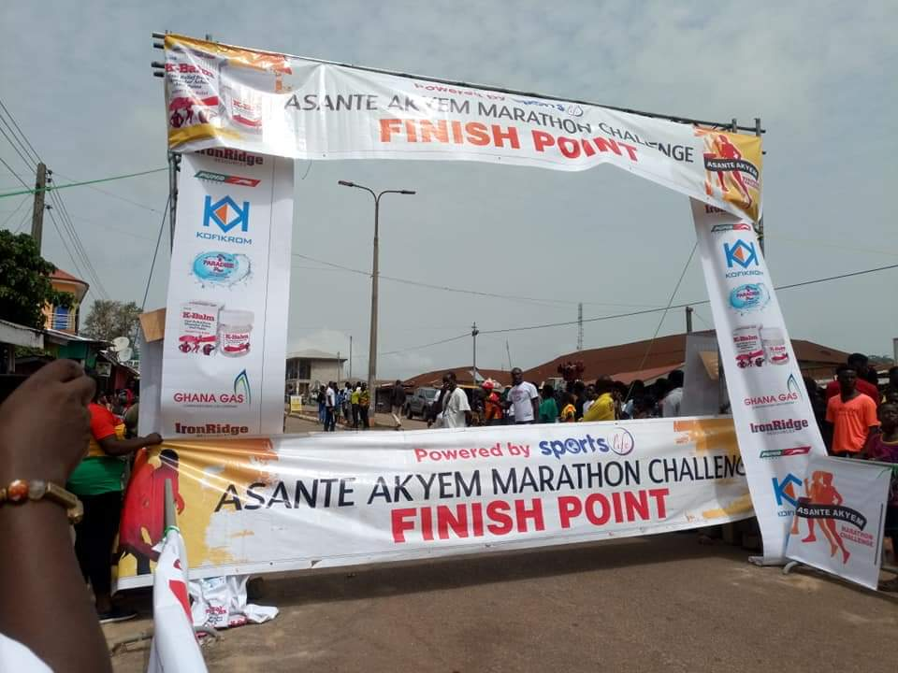
NSA, Hon Kwadwo Baa Agyemang organized a Marathon at Asante Akyem
22, April, 2019
Prof Twumasi attended a Marathon at Asante Akyem organized jointly by Hon Kwadwo Baa Agyemang and the National Sports Authority (NSA) at Agogo in Ashanti Region. The competition started at 6:00am and ended with presentation of assorted prize packages, certiﬁcates and medals to the winners. It involved male and female athletes at junior and senior levels. In all, about 300 athletes from across the country took part in the competition. He congratulated organizers, participating athletes, media, chiefs and people of Asante Akyem for organizing the third edition of the marathon in the area.

Slide 13
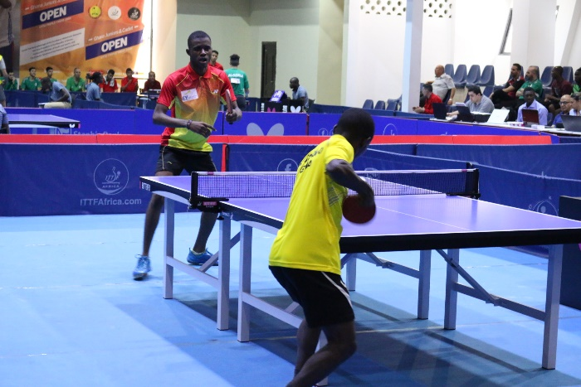
Ghana Host International Table Tennis Federation World And Africa Junior/Cadet, Championships
1st to 6th April 2019
The Ghana Table Tennis Association hosted the aforementioned events at the Trust Sports Emporium in Accra, from 1st to 6th and 7th to 13th April 2019 respectively. Ghana bagged one gold, one silver and six bronze medals in the world championship category, but failed to win a medal in the African championship.
Ghana’s brightest point in the world junior and cadet championship was Ibrahim Gado who won gold in the single’s final match with a 3-0 win victory over DR Congo’s Neredi Bovoyi. Egypt emerged the best team in the African championship with seven gold medals to their credit.

Slide 14
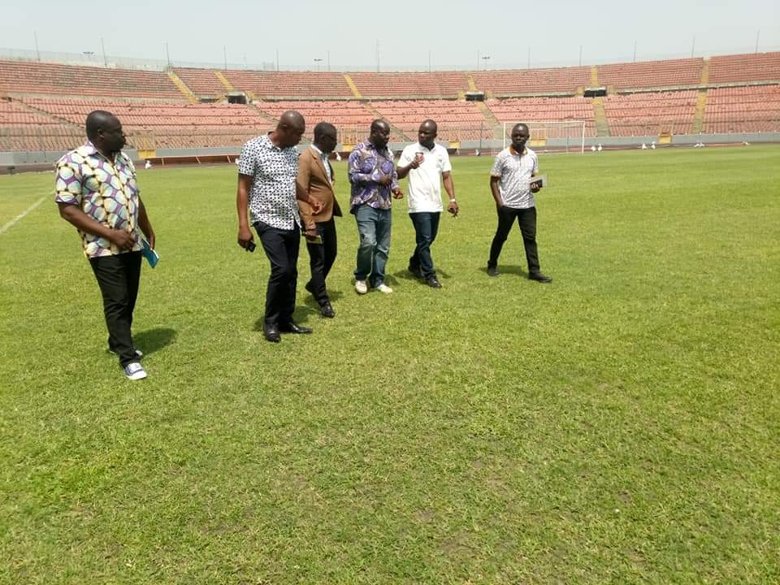
NSA Contracted Green Grass Technology Company To Upgrade Pitches
Nationals Sports Authority signed an agreement with Green Grass Technology Company to upgrade pitches in Kumasi, Accra, Tamale and Cape coast Sports Stadia to international standards to host CAF matches including Confederation Cup, Champions Cup, AFCON, Olympics Qualifier etc.

Slide 15
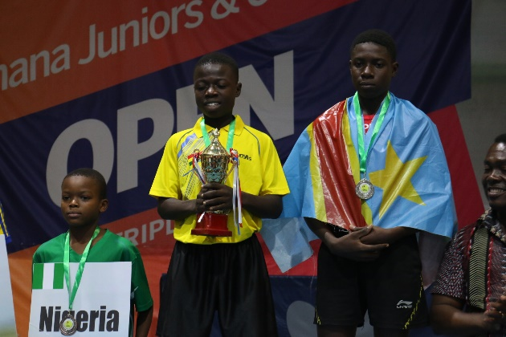
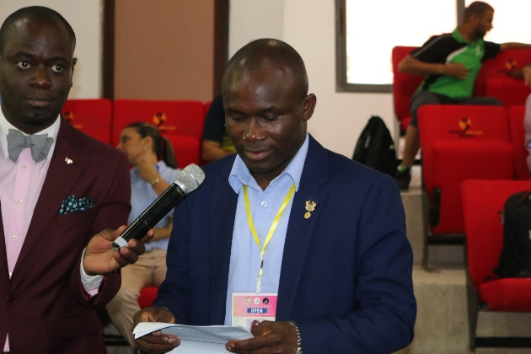
Ghana Hosts Itf Tournament
7th to 13th April 2019
The Tennis Courts of the Accra Sports Stadium was alive with impressive display of Tennis when the Ghana Tennis Federation (GTF) hosted the International Tennis Federation (ITF) 18 and under World Junior Circuit Tour in Accra. The week long competition saw 64 players from 20 countries participating in the ITF certified tournament. The tournament was sponsored by Mcdan Group of companies, Hollard, Vitamilk, Ann Mineral Water and the Ghana Tennis Foundation.

Slide 16
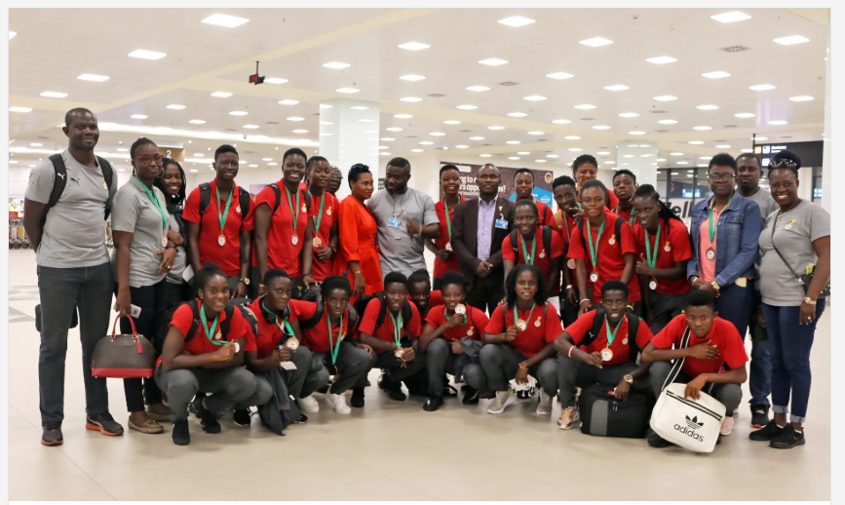
NSA Director congratulates Black Queens
1st to 6th April 2019
The Director General for National Sports Authority, Hon. Professor Peter Twumasi has congratulated the Ghana National female team, the Black Queens for their heroics at the just ended WAFU Zone B tournament held in Cote D’ivoire.
Hon. Professor Twumasi, who joined a team of Officials including the NSA Board Chairman Honorable Kwadwo Baah Agyemang and Madam Naa Odofoley Nortey a member of the Ghana Football Normalization Committee to welcome the Black Queens at the Kotoka International Airport upon their return noted that, though the team couldn’t defend the trophy won in the previous edition, they had performed well to consistently be in the top three.

Slide 17
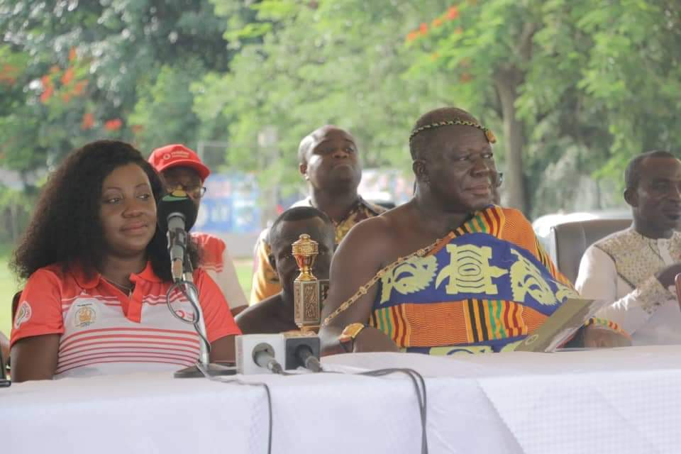
Otumfuo's Golf Championship at Royal Golf Club
13, May, 2019
Prof Twumasi attended a Closing Ceremony of Otumfuo's Golf Championship at Royal Golf Club in Kumasi as part of 20th Anniversary of the King's Coronation. Present at the ceremony were His Majesty Otumfuo Osei Tutu II, Asantehene, Hon Isaac Kwame Asiamah, Minister of Youth and Sports, Prof Peter Twumasi, Director General of National Sports Authority, CEOs of Vodafone and CalBank, and other important dignitaries

Slide 18
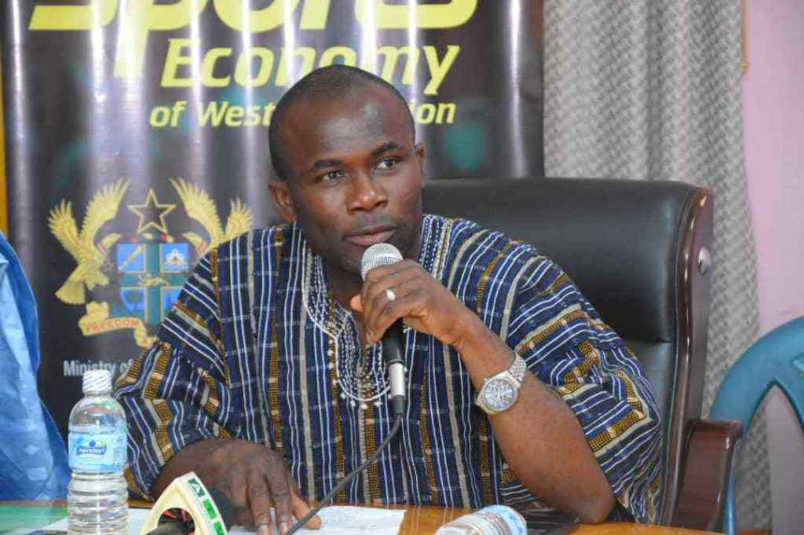
Western Regional Sports Committee Strategic Workshop
31st May, 2019
THEME – Awakening the Sport Economy of Western Region
DATE – Friday 31st MAY, 2019
VENUE- Takoradi
The event which was organized by the Western Regional Coordinating Council in collaboration with the Western Regional Sports Directorate – NSA.
The committee resolved to pursue the under listed objectives :
To surmount any media challenges to promote WR sports development Essipon Stadium repairs to be put on top priority by Gov’t and NSA and plans laid down to put facility into full use.
To align District Sports investments and plans to achieve strategic vision of the region 4, Sponsors and Corporate Responsibility Managers of our Corporate Industries to have renewed confidence in leadership of WRSC to attract funding and other resources.
Sports Talents, Administrators and Managers must see hope and be inspired to work harder, be more committed and disciplined so as to take advantage of new opportunities and energies

Slide 19
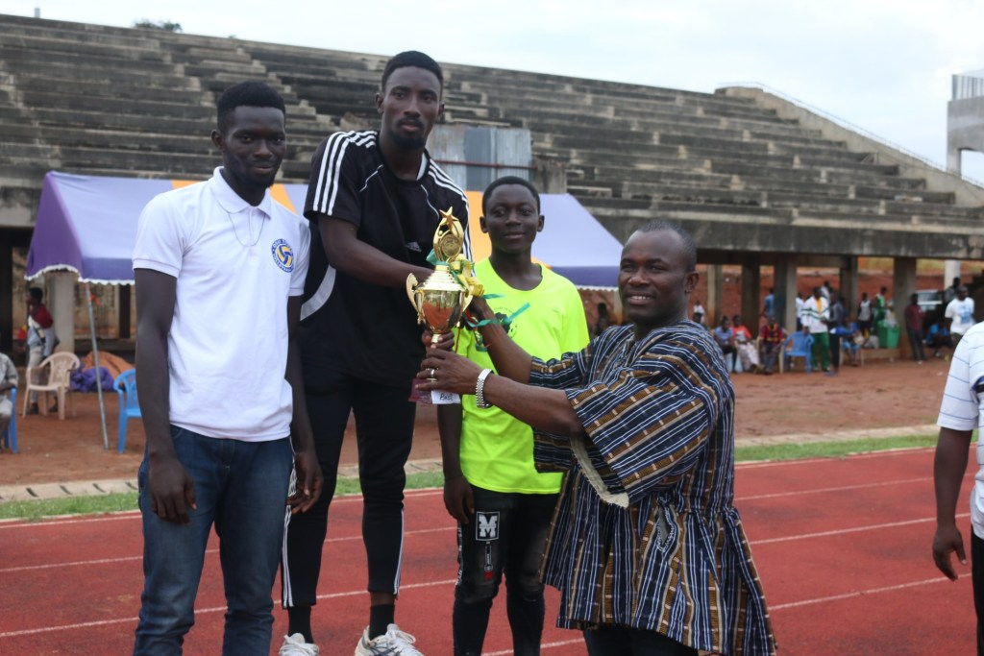
Greater Accra Inter-District sports festival
June 03 – 07, 2019
The 2019 Inter-District Sports festival aimed at unearthing talents to feed the various National teams for future events has officially commenced in Accra, with 25 districts in the Greater Accra Municipality participating in the four-day sports festival.
The event, organized under the auspices of the Greater Accra Regional Sports Authority in collaboration with the Regional Coordinating Council and the National Sports Authority under the theme “Sports, an instrument to National Development” would see the various districts battling it out in sporting disciplines like football, handball, basketball, table tennis, volleyball and athletics.
The Director General for National Sports Authority (NSA) Professor Peter Twumasi, who was the guest of honour, in a speech thanked the organizers of the Sports Festival for the efforts made towards the sustenance of the festival, which was revived last year. According to him, this serves as a platform for grassroots and the mass participation in sports, talent identification of athletes to feed the various national teams.

Slide 20
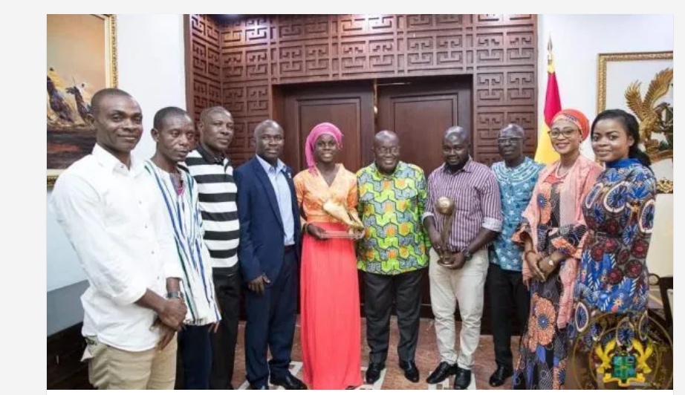
Prof. Peter Twumasi assisted Ms Mukarama Abdulai to present her 2018 U-17 Women’s World Cup Golden Boot
21st June, 2019
On Thursday, Prof. Dr. Peter Twumasi assisted Ms Mukarama Abdulai, on behalf of Hon Isaac Asiamah, Minister of Youth and Sports, to present her 2018 U-17 Women’s Word Cup Golden Boot (top scorer) and Bronze Football (Third Best Player) to the President, H.E. Nana Addo Dankwa Akufo-Addo.
Later, the Honorable Minister on behalf of the President and people of Ghana presented Thirty Thousand Ghana Cedis to Ms Mukarama Abdulai in appreciation of her commitment to Ghana Sports.

Slide 21
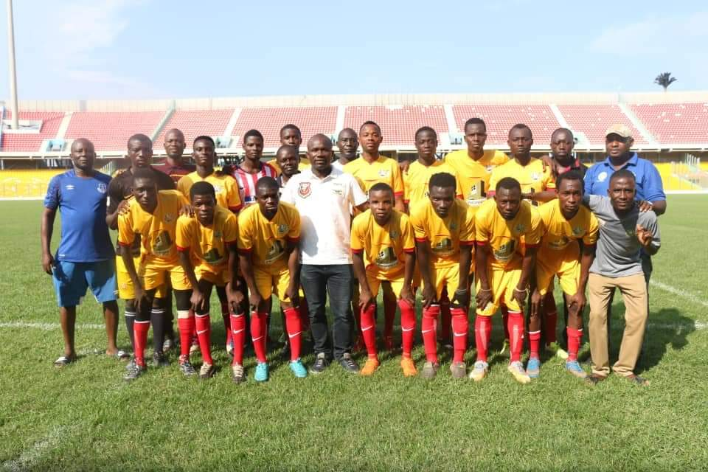
Ghana Deaf Football Association Ceremonial match
22, June 2019
National Sports Authority attends Ghana Deaf Football Association Ceremonial match played today at the Accra Sports Stadium on the 72nd Birthday of Former President Rawlings. In attendance were Head of Technical Department of National Sports Authority, Mr Wilson, and Head of Monitoring and Evaluation, Mr Kwame Baa.

Slide 22
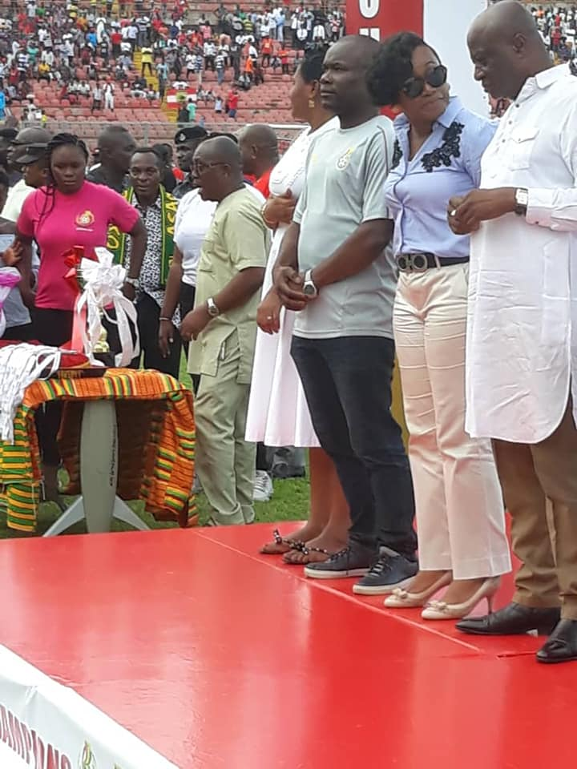
Kumasi Asante Kotoko beats Karela FC
24th June, 2019
Professor Peter Twumasi was present at the Baba Yara Stadium in Kumasi where Asante Kotoko beat Karela FC in the finals of the NC GFA Tier 1 to qualify to represent Ghana in the next CAF Champions League. Scoreline was 4:1 on penalties after a one all draw in the 90 minute playtime. Present to grace the occasion were Deputy Minister of Youth and Sports, Hon Perry Okudjetto, Director General of National Sports Authority, Prof Peter Twumasi, Majority Leader of Parliament and Minister of Parliamentary Affairs, Hon Osei Kyei Mensah Bonsu, and Chairman of Normalization Committee of GFA, Dr Kofi Amoah.

Slide 23
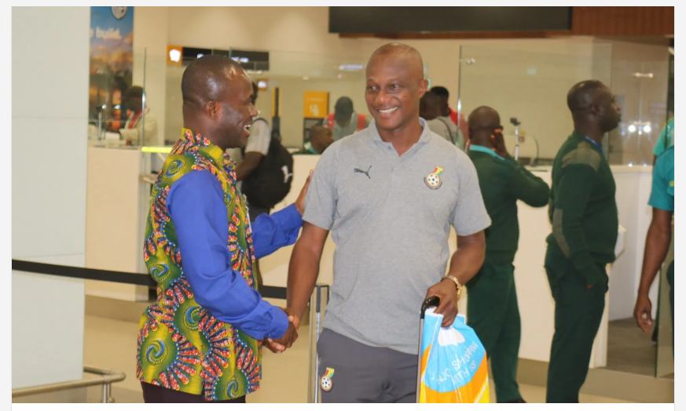
Prof. Peter Twumasi Welcomes The Black Stars
11th July, 2019
After the painful exit of the Senior National Team( Black Stars )from the 2019 African Cup of Nations (AFCON), they touched down at the terminal 3 of Kotoko international airport in the early hours of July 11th, 2019. The stars were welcomed by Prof. Peter Twumasi, the director-general of the National Sports Authority(NSA)
Though the players were not in their usual high spirits and couldn’t deliver as expected of -them, Prof. Peter Twumasi gave them a very warm welcome and congratulated them immensely for all their hard work and effort.

Slide 24
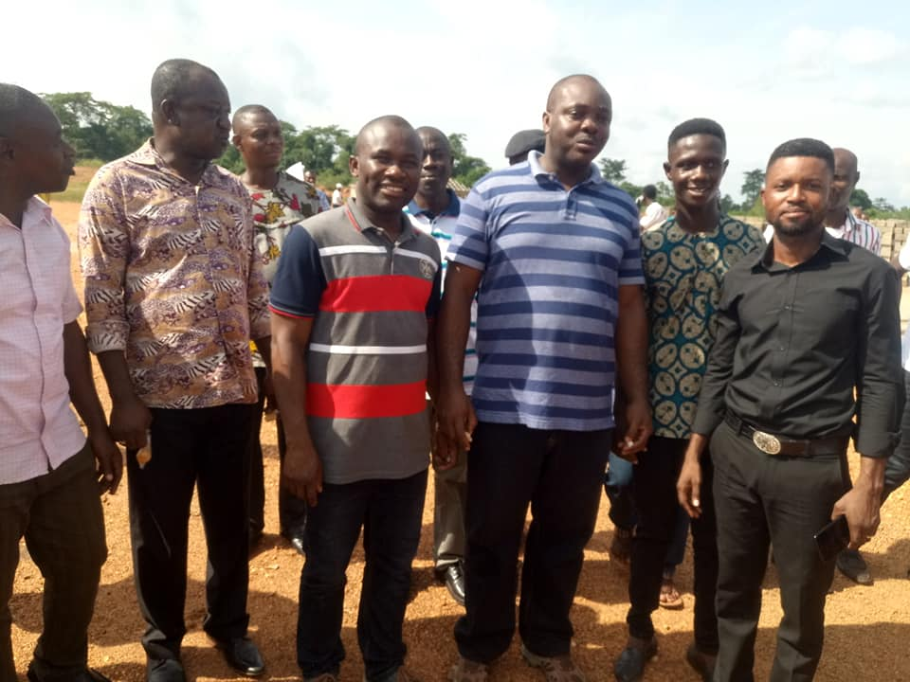
Work is expected to resume on the stadium construction at New Edubiase
June 17th, 2019
Monday June 17, 2019: Work is expected to resume on the stadium construction at New Edubiase as disclosed by the Minister of Youth and Sports, Hon Isaac Asiamah, during a one day visit to the site in the Ashanti Region. Dignitaries present includes the Queen Mother of Edubiase, and Ashanti Regional Minister, Hon Simon Osei Mensah

Slide 25
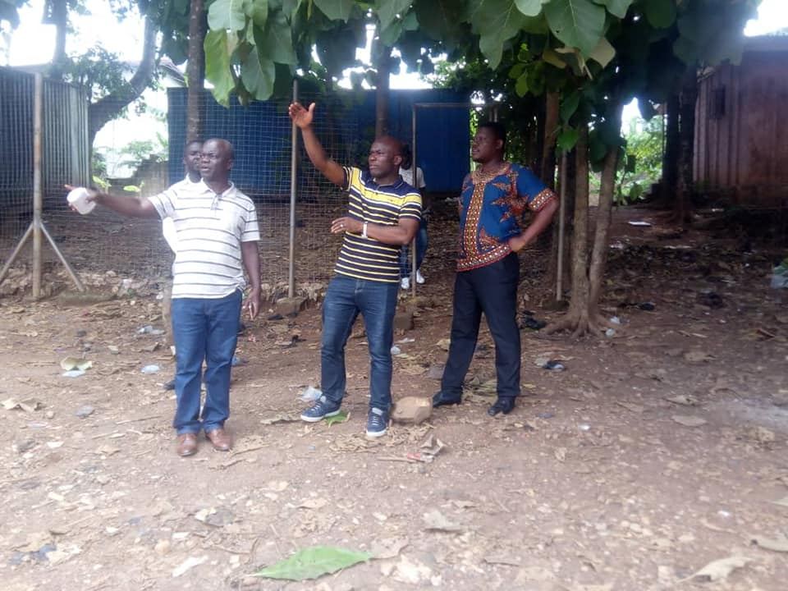
Ashanti Regional NSA Directorate Has Uncovered A Parcel Of Land Belonging To The Authority
19th June, 2019
Ashanti Regional NSA Directorate has uncovered a parcel of land at Kwadaso which belongs to the Authority and it is earmarked for development into community sports complex. The Government of H.E. Nana Addo Dankwa Akufo-Addo through Ministry of Youth and Sports and the National Sports Authority has embarked on an extensive sports infrastructure development across the country to bring sports facilities to the doorstep of the citizenry. This will tremendously boost nurturing of talents in sports in the country, with consequent positive economic and social impact.

Slide 26
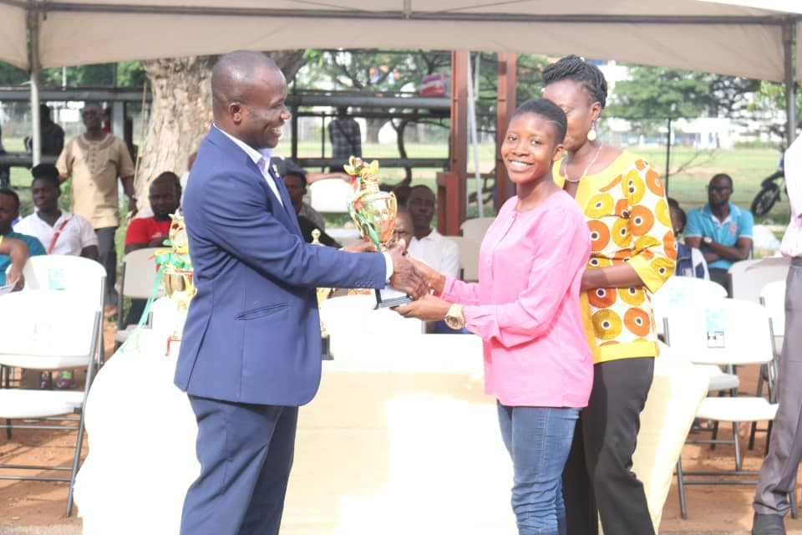
Greater Accra Regional Sports Festival
4th June, 2019
At the opening ceremony of the revived Greater Accra Regional Sports Festival for inter district sports competitions held at University of Ghana Campus, Legon. Present at the opening ceremony were the Greater Accra Regional Minister, Hon Ishmael Ashitey, and Member of Parliament for Ayawaso West Wuogon, Hon Lydia Alhassan. A total of 26 districts in the regions are competing in various disciplines including Athletics, Badminton, Soccer and netball. Other regions are expected to organize similar competitions to aid unearthing of talents at the grassroots. This is in fulfilment of Hon Isaac Asiamah's quest to revive school sports and other grassroot sports. Thanks to the Greater Accra Regional Director of National Sports Authority, Mr Iddrisu, and his staff as well as Hon Minister and the Regional Coordinating Council (RCC) for helping to organize this five day sporting tournament.

Slide 27
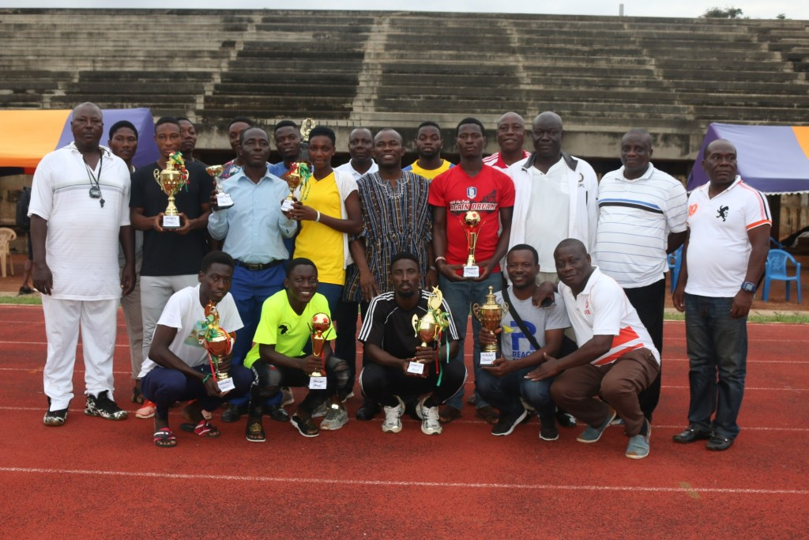
Inter-district Sports Festival Commences In Accra
7th June, 2019
The 2019 Inter-District Sports festival aimed at unearthing talents to feed the various National teams for future events has officially commenced in Accra, with 25 districts in the Greater Accra Municipality participating in the four-day sports festival.
The event, organized under the auspices of the Greater Accra Regional Sports Authority in collaboration with the Regional Coordinating Council and the National Sports Authority under the theme “Sports, an instrument to National Development” would see the various districts battling it out in sporting disciplines like football, handball, basketball, table tennis, volleyball and athletics.
The Director General for National Sports Authority (NSA) Professor Peter Twumasi, who was the guest of honour, in a speech thanked the organizers of the Sports Festival for the efforts made towards the sustenance of the festival, which was revived last year. According to him, this serves as a platform for grassroots and the mass participation in sports, talent identification of athletes to feed the various national teams.

Slide 28
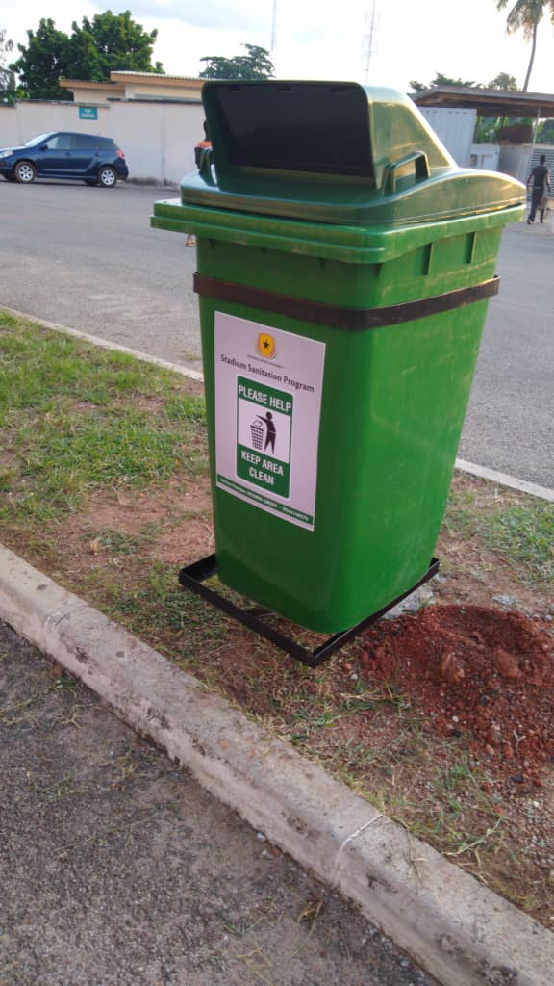
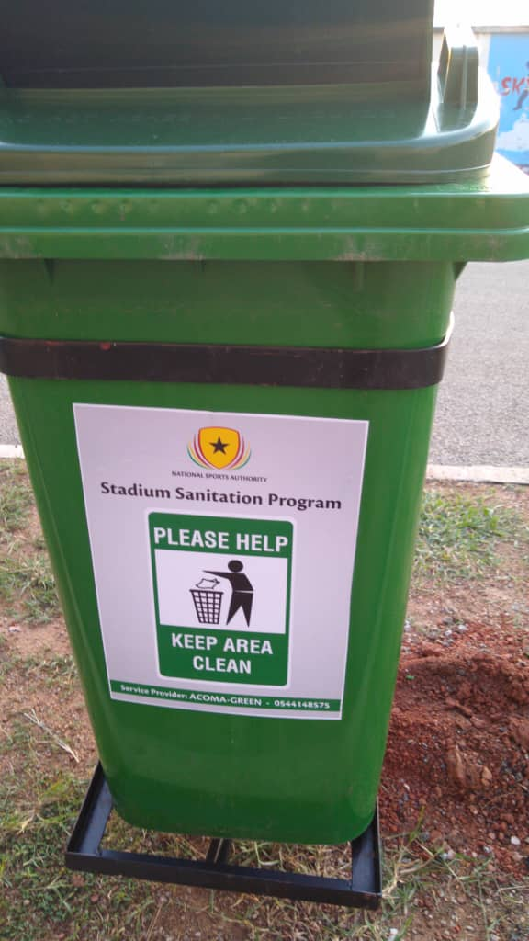
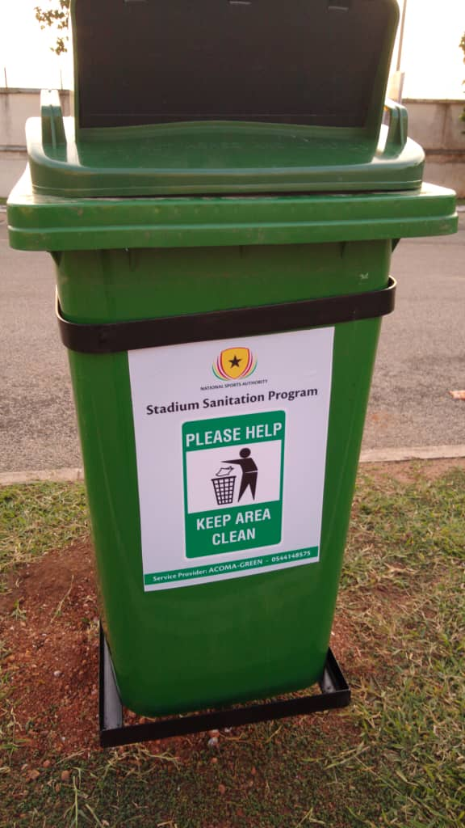
Installation of Bins at the Stadiums
The Director-General of the National Sports Authority distributed 100 bins each to the Accra and Baba Yara Sports Stadia.
This according to him is a move to effectively manage waste and beautify the stadium.

Slide 29
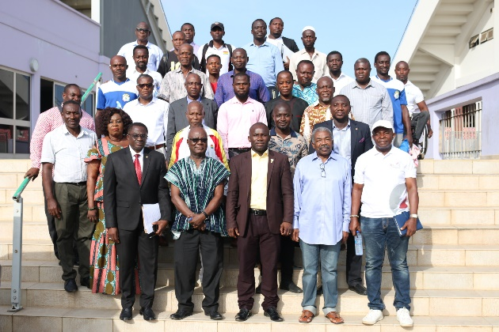
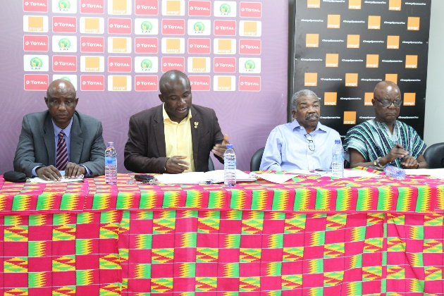
IGCC holds maiden press conference ahead of African Games
27th June 2019
The International Games and Competition Committee (IGCC) has on Thursday 27th June 2019 held its maiden press conference at the Accra Sports Stadium, aimed at giving the general public an insight about its activities heading into the upcoming African games scheduled for Rabat, Morocco.
Chairman for the IGCC, Professor Peter Twumasi, Director General of the National Sports Authority (NSA), noted that the IGCC mandated with the responsibility for all preparations toward the African Games in August 16 to September 1, 2019 has had a lot of fruitful deliberations and was appropriate they made them known to the various stakeholders.
According to Professor Twumasi, the IGCC is to determine the sporting disciplines that will represent Ghana in the upcoming games.
“The committee is responsible for determining the requisite sporting discipline that will partake in the games and also allocate actual numbers for each sport, taking into consideration international federations and games requirements.
“We have also been tasked to decide with the appropriate federations, associations or institutions on sports equipment, kitting and general costume for all contingents” he added.

Slide 30
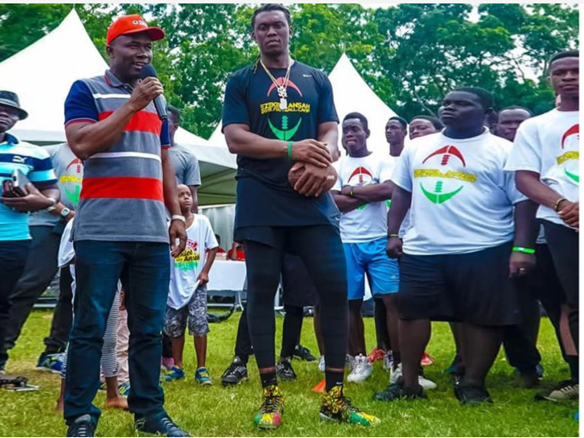
Opening Of The 3rd Football Camp Organized At University Of Ghana
30th June, 2019
Prof. Peter Twumasi represented the Minister of Youth and Sports, Hon Isaac Asiamah, at the opening of the 3rd Football Camp, organized at University of Ghana campus, Accra, by American Football League (NFL) player, Ezekiel Nana “Ziggy” Ansah, a Ghanaian who played for Detroit Lions and currently loaned to Seattle Seahawks. Assisted by his playing mates from the United States, and some local coaches, over 500 students from six Senior High Schools and other volunteers, received lessons in American Football. Mr. Ansah’s six-year contract is estimated to be over 30 million US dollars.

Slide 31
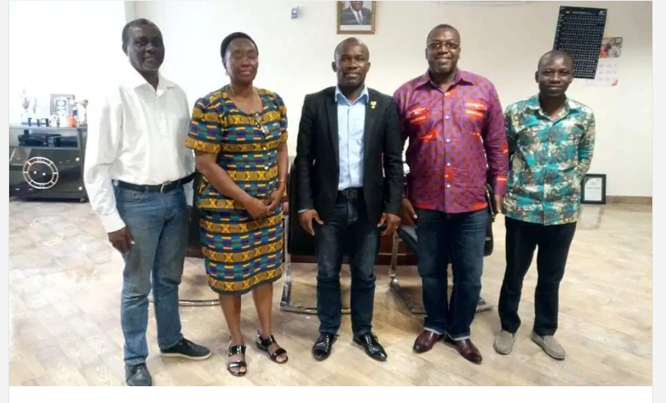
Prof Twumasi Meets A Delegation To Discuss Matters Relating To Development And Promotion Of Hockey
20th July, 2019
Prof. Peter Twumasi, The Director-General of The National Sports Authority received a delegation from Ghana Hockey Association led by their President Dr Ben Asante, who is also the CEO of Ghana Gas Company, for discussion on matters relating to development and promotion of Hockey in Ghana and beyond. Present at the meeting were Acting Head of Technical Department of NSA, Mr Abeku Wilson, and Member of Ghana Hockey Association and an elected Executive member of the International Hockey Federation, Mrs Elizabeth King.

Slide 32
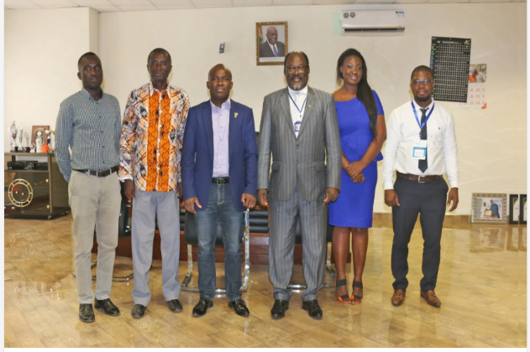
Management Aiming At Strengthening the Medical Component Of The Authority
July 24th 2019
On Wednesday, July 24 2019, The Director-General of the National Sports Authority meets with a team of Medical Officer to deliberate on a proposal with management aimed at strengthening the medical component of the Authority.
Prof. Abraham Kwabena Annan, Director of Noguchi Medical Centre of the University of Ghana, led the team made up of officers from other health institutions.
The Authority hopes to assemble all functional components of sports including advanced coaching training, athletes’ health, various technologies and sports infrastructure development for overall development and promotion of sports.

Slide 33
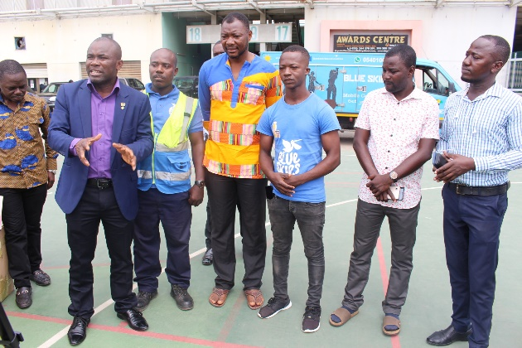
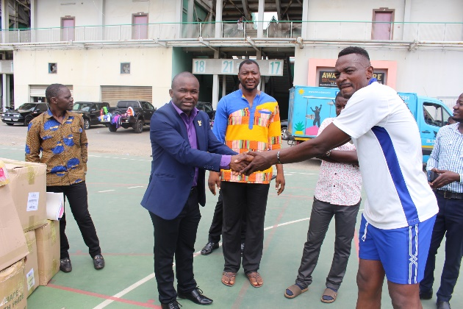
Presentation To The National Volley Ball Team Prior To The Zone Three Nations Cup In Accra
30th July, 2019
Prior to the Zone III Volleyball Nations Cup tournament to be held in Ghana from 2nd-9th of August, the Director-General of the National Sports Authority, Prof. Peter Twumasi met the National Volleyball team during their training session at the Accra Sports Stadium today. Interacting with the players and officials of the team, he stated that the Authority will provide support to all disciplines including volleyball, in their quest to excel at both the local and international front. He said The Authority will support the volleyball team with some amount of money to assist them in their upcoming tournament at the Lebanon House, Tudu, Accra.
Blue Skies Company Limited visited the team and donated beverages to support them ahead of the tournament. On behalf of the National Sports Authority and the Government, Prof. Twumasi expressed his appreciation to the team and hoped that other corporate bodies will emulate and support sporting activities in the country.
The National Volleyball team coach, Mr. Iddrisu Bawa expressed his gratitude to the National Sports Authority and Blue Skies Company for their immense contribution towards their preparation in hosting the tournament and hope to do their best to win the trophy at stake.

Slide 34
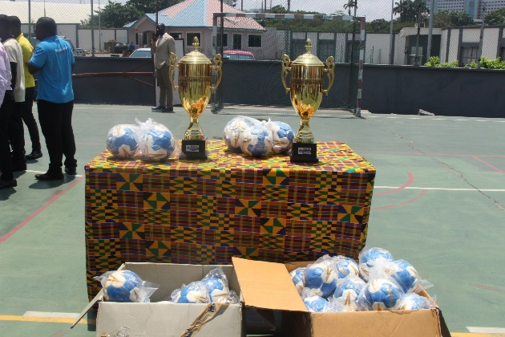
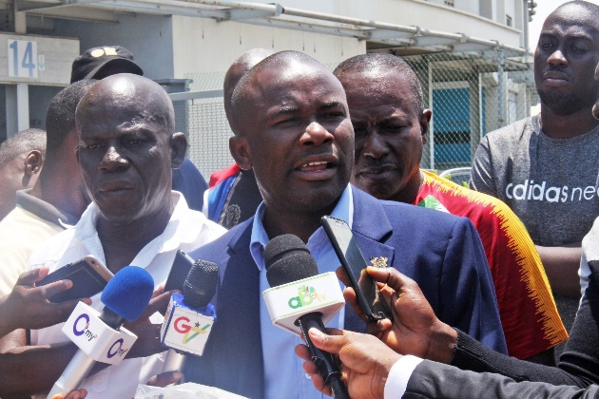
NSA Supports Handball Association Of Ghana
9th August, 2019
The National Sports Authority (NSA) has supported the handball Association of Ghana with an amount of four thousand Ghana Cedis to enable the latter to clear some handballs at the port. Presenting the balls to the Association at a short ceremony in Accra, the Director-General of NSA, Prof. Peter Twumasi said his administration is determined to support all affiliate sports federations to develope locally, so as to enable them to excel at the International level.
Present at the ceremony were some handball teams from Greater Accra and Executive members of the handball Association, including the acting Chairman Mr Nortey Dowuona. In a related development, Prof Peter Twumasi presented a trophy to the prisons Handball team for winning the 2018 edition of the Greater Accra handball league.

Slide 35
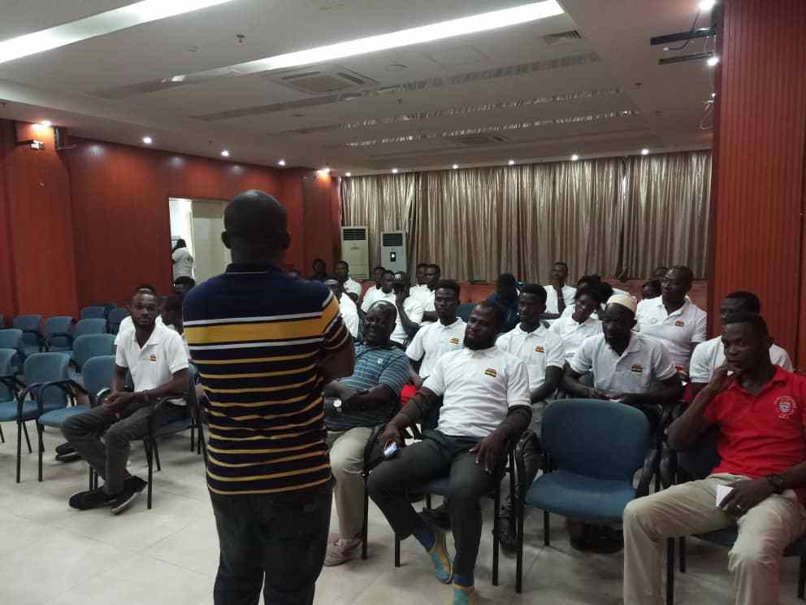
Team Ghana Arrives In Cape Coast For Residential Camping
3rd August, 2019
c
On behalf the President of Ghana, HE Nana Addo Dankwa Akufo-Addo, and the Minister of Youth and Sports, Hon Isaac Asiamah (MP), Prof. Peter Twumasi welcomed athletes and coaches from 14 disciplines into residential camping in the Cape Coast Stadium on Saturday 3rd August 2019. This was during the arrival of Team Ghana in Cape Coast for the final preparation towards the 2019 African Games in Rabat, Morocco.
Together with the NSA Regional Director, Mr George Osafo, Mr George Owusu Ansah, Chairman of Logistics Sub Committee of the International Games and Competitions Committee (IGCC), and other technical officers, they inspected the facilities available in the stadium to support the training of the athletes. Later, he met with the athletes and welcomed them to the facility. He then assured them of Government’s support for the competition and advised them to exercise the highest form of discipline in the camp. He also praised the technical team including the federations and associations for their professionalism in nurturing the teams.

Slide 36
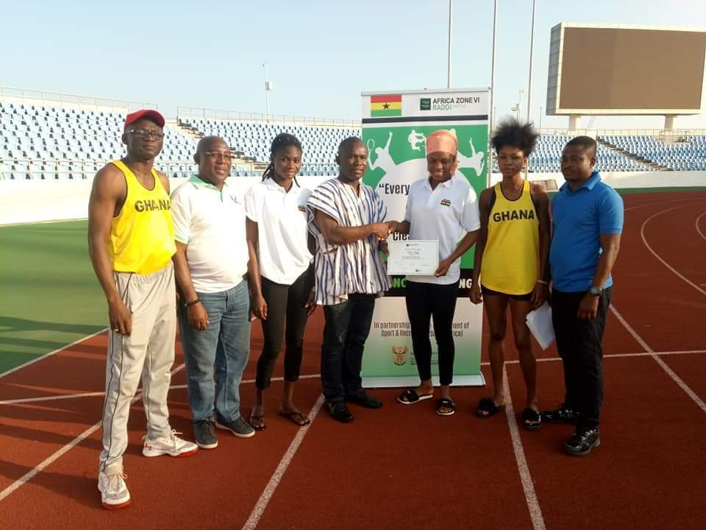
Prof. Peter Twumasi Paid A Working Visit To Team Ghana At The Cape Coast Sports Stadium
10th August, 2019
International Games and Competition Committee Chairman, Prof. Peter Twumasi, who doubles as the Director-General of the National Sports Authority, paid a working visit to Team Ghana’s Camp at the Cape-Coast to inspire them ahead of the African Games in Rabat.
Together with Mr George Osafo, NSA CR Director, they visited the players on their training grounds to get first hand information on conditions in Camp. He also received briefing from the Anti-doping Team (led by Mr Prince Azanu) of the Medical Sub-committee which is stationed at the camp to test, counsel and clear athletes to compete.
He assisted them to present clearance certificates to the athletes and also interacted with the Dietitian in the Camp, Ms Justine Sitsofe, concerning the feeding and nutritional health assessment of the athletes. She was satisfied with the menu provided for the athletes. The condition in Camp is excellent, athletes and Coaches are extremely satisfied and standard training equipment are available to them.

Slide 37
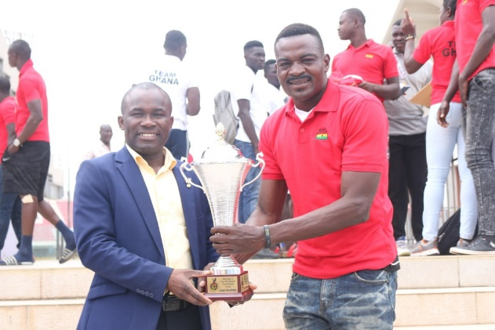
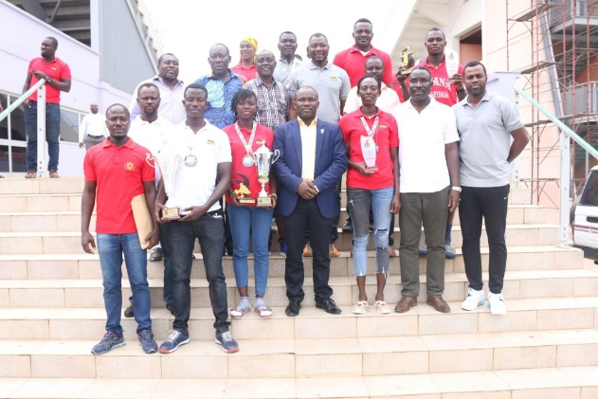
Black Spikers presents Gold trophies to NSA
15th August, 2019
c
Ghana’s Senior National Volleyball team(Male and Female), the Black Spikers presented Gold trophies they won at the recently organized 2019 Zone 3 Cup of Nations tournament to Prof Peter Twumasi, Director-General of the National Sports Authority at the Media Center of the Accra Sports Stadium stadium.
Other individual awards such as the Best Libero, Best Player (both Men and Women) and the Best Attacker were also presented to him.
In his address, Prof. Twumasi commended the team for beating all their competitors to emerge as winners of the tournament. He pledged the National Sports Authority and the Ministry’s support for the team and further disclosed an amount of Five Thousand Ghana Cedis (Gh5,000.00) pledge to them for their outstanding performance.
Present at the brief ceremony were Prof. Twumasi(DG, NSA), Mr Wilson Abedu(Ag. Head of Technical, NSA), Mr George Tettey(Vice President of GVA), Mr Charles Amofah (PRO, NSA), Mr Kwadwo Fordjour (Vice Chairman of the LOC), Hon. Bernard Mornah(Member if the LOC) and Mr Alhassan Sumani(Ag. Secretary-General of the GVA

Slide 38
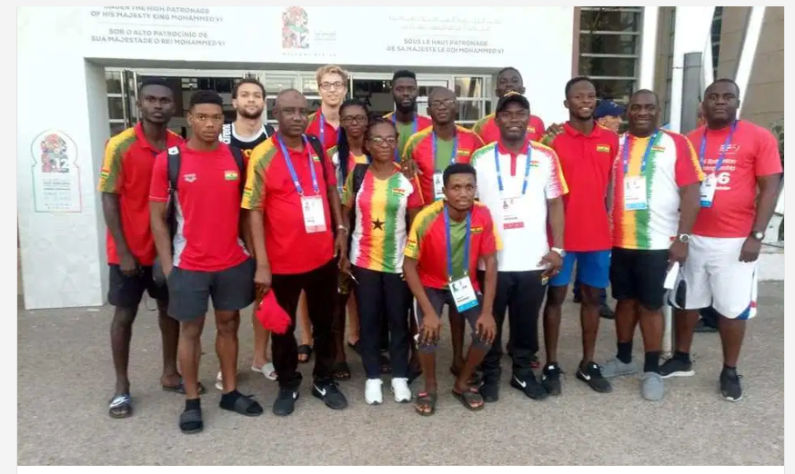
Prof. Twumasi Visits Team Ghana To Evaluate Conditions at The Camp
24th August, 2019
The Chairman of IGCC, Prof Peter Twumasi visited the teams stationed in Casablanca (Cycling, Swimming and Badminton) to evaluate conditions in the camp and to whip up morale among the athletes. Mr Tufuor (Koora), Deputy Chef de Mission, and in charge of the camp, praised the athletes for their good behaviour in camp and the seriousness attached to the competitions.

Slide 39

Western Region Invitational Tournament To Be Launched Today
25th August, 2019
c
The invitational tournament is an idea born by the Regional Minister Hon. Kobby Darko Mensah to get teams in the region engaged during the preseason.
The tournament’s main goal is to help clubs from the region to prepare adequately for upcoming competitions in the country.
The Western Regional sports committee set in May this year were tasked to ensure the tournament became a reality and this year eight clubs from the region including top Ghana Premier League side Medema FC will participate in the competition.
The 7 members western regional sports committee is chaired by Hon Wilson Arthur with Rok FMS Kweku Sagoe being a member and spokesperson for the committeeApart from the Mauves and Yellows, the other premier league side is Karela United and five other clubs from the Division One, namely Skyy FC, Proud United, Nzema Kotoko, Sekondi Hasaacas and Samartex.Division two side and one of the oldest club in the country Sekondi Eleven Wise will complete the group of clubs for the tournament.The tournament has been slated for 15th to 22nd September and the venues for the competition are the Essipong and Samartex Park.

Slide 40
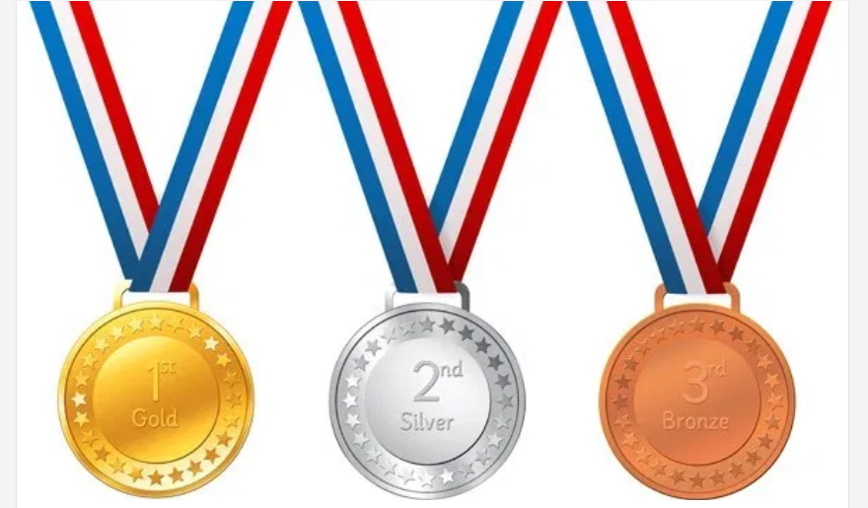
Medalists For Team Ghana In The 2019 African Games
1. Winnifred Ntumi – 3 bronze (Weightlifting, Women’s 45kg)
2. David Akwei – 1 bronze (Weightlifting, Men’s 61kg)
3. Rose Yeboah Amoanimaa – 1 Gold ( Athletics, Women’s High Jump 1.84)
4. Grace Obour – 1 bronze(Athletics, 400m 51.86)
5. Men’s 4x100m Relay team, Sean Safo-Antwi , Benjamin Azamati , Martin
Owusu-Antwi & Joseph Paul Amoah – 1 Gold ( Athletics, 38.30 )
6. Christian Amoah – 3 bronze (Weightlifting, Men’s 89kg)
7. Forrester Osei – 1 Silver (Weightlifting, Men’s 89kg)
8. Shakul Samed – 1 bronze (Boxing, Men’s Light Heavyweight 81kg)
9. Deborah Acquah – 1 Silver ( Athletics, Women’s Long Jump 6.37 )
Gold – 2 , Silver – 2 , Bronze – 9

Slide 41






African Games, Rabat 2019

Slide 42

NSA Boss Visits Nyinahin Stadium To Inspect Ongoing Stadium Project Under Construction
9th September, 2019
The Director-General of the National Sports Authority, Prof. Peter Twumasi together with Hon Isaac Asiamah, Ghana’s Minister of Youth and Sports visited the Nyinahin Stadium site to inspect the ongoing project which is part of the ten (10) new stadia under construction by Government in the ten old regions.
Work has advanced and the pitch is being grassed and stands roofed. The facility with 500 seating capacity is expected to host about 20 sporting disciplines as well as IT training centres and hostel facility (70-bed capacity).

Slide 43


NSA Donates To The GPF
2019/10/17
The National Sports Authority (NSA) has donated an amount of Ghȼ10,000 to the Ghana Powerlifting Federation.
At a brief ceremony, this afternoon in Accra, the Director-General of the NSA Professor Peter Twumasi congratulated the federation for their remarkable achievement at the just ended Commonwealth Games in Canada adding that, the gesture is intended to support the federation so as to help develop the Powerlifting discipline.

Slide 44

Ghana, Colombia to Partner for Sports Development
2019/10/10
Ghana and Colombia are considering a partnership that will see the two countries share expertise in sports development and promotion.
This came to light when the Colombian Ambassador to Ghana, Claudia Turbay Quinterom her Special Assistant and two paralympic trainers met with a delegation of top Ghanaian sports officials.

Slide 45


NSA Donates To Hockey Association
2019/09/19
The National Sports Authority has presented a sum of Ghc 10,000 to The Ghana Hockey Association in Accra.
At a brief ceremony at the Accra Sports Stadium yesterday, the Director General of the NSA, Professor Peter Twumasi said the amount was given to the association by the NSA as a form of appreciation for their sterling performance at the just ended African Games hockey championship in South Africa.

Slide 46






Renovation Of The Accra Sports Stadium

Slide 47




A Renovated Accra Sports Stadium

Slide 48

Establishment Of A New Website For The Authority-
www.sportsauthority.gov.gh

Slide 49

Establishment of a New Website for the Authority-
www.sportsauthority.gov.gh

Slide 50

Establishment of a New Website for the Authority-
www.sportsauthority.gov.gh

Slide 51
NSA supplies 10 Regions with Detergents, Chemicals and Stationery.
9th September, 2019
The Director-General of the National Sports Authority, Prof Peter Twumasi Supplied the various sports stadia in 10 regions across the country with a one year cleaning detergents and chemicals to assist in the general cleaning and maintenance of the stadium facilities. NSA also supplied the regions with stationery expected to last for a year

Slide 52
Proposed Projects
NSA TV
Community park development Submitted by KNUST Architecture and Horticulture Group ( 200 of the project is been considered for funding )

